Slide 1
News-induced Dynamic Networks for Market Signaling: Understanding Impact of News on Firm Equity Value
Kun Chen, Xin Li, Peng Luo, and Leon Zhao
Presenter: Charles Tian, Hefei University of Technology
2025.4.21

Slide 2
Title
News-induced Dynamic Networks for Market Signaling: Understanding Impact of News on Firm Equity Value
“induced”: Generated(Derived) from.
“understanding impact of ... on ...”: They may evaluate the impact of networks by econometric models.
They may use text-mining approach to derive a dynamic network and use econometric models to evaluate the network’s impact.

Slide 3
Contributions to our Community
I try to contribute to our community by:
illustrating the emerging trend of integration between design science and economics by presenting this work. Unlike other articles, This paper uses design approach to identify two new variables as independent variables to econometric model, serving as a typical example of integrating design science and economics.
clearly explaining this paper’s methodology, discussing its potential improvements, and recommending some related articles(in appendix). This paper designs a text-mining approach to extract networks from news, which is very similar to my own research techniques and area.

Slide 4


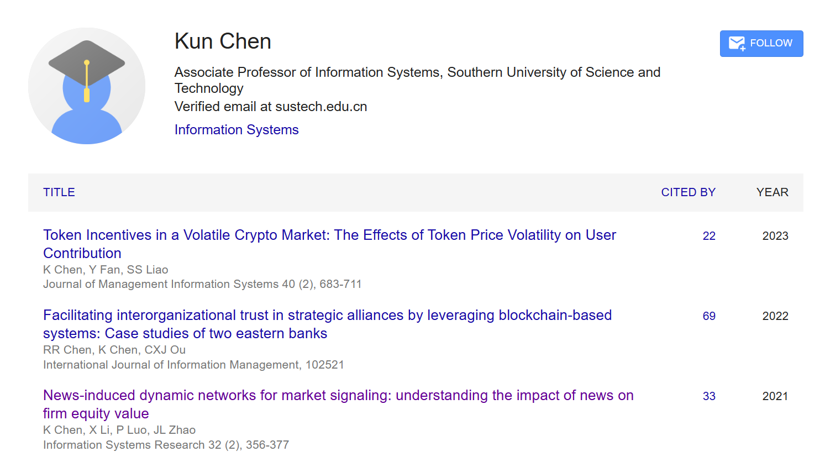
Authors

Slide 5
Introduction
How to evaluate a company’s market potential? A promising direction is by its business relations and competitive environment.
Previous studies focus on relatively stable and long-term cooperation and competition relations of firms. For example, (Asness et al. 2000; Madhavan et al. 2004) identified that firm alliances influence firm behaviours and outcomes.
However, stable relations require efforts to obtain and update and thus are not easy for individual investors, and the stability of these relations makes them incapable of predicting the dynamics of financial market.
Motivation 1: Only using stable relations to evaluate a company’s market potential is insufficient, leading us to explore dynamic relations.

Slide 6
Introduction
The dynamic nature of news enables us to induce dynamic firm relations. Such news does update investor perceptions of recent firm operations and relations and influence their short-term investment relations.
Public news has been used to understand the dynamics of the economy and the market. Prior studies have confirmed that the appearance of certain events (Mahajan et al. 2008) and sentiments (Das et al. 2007) in news influences investor behaviors and causes changes in the stock market. However, they often focus on investor perceptions on individual firms or industries.
Motivation 2: Can we further understand market signaling by exploiting dynamic relations from news?

Slide 7
Introduction
Research Questions:
1 How to define and extract insightful dynamic networks from news?
2 What’s the impact of news-induced networks on market signaling?
Takeaways:
Part 1: text-mining based network extraction
define semantics of networks and design a text-mining approach to exploit it from news
comparing between other networks to further illustrates its semantics
Part 2: leveraging econometric model to understand the impacts of networks
Hypothesis definition and model construction
Empirical Results

Slide 8
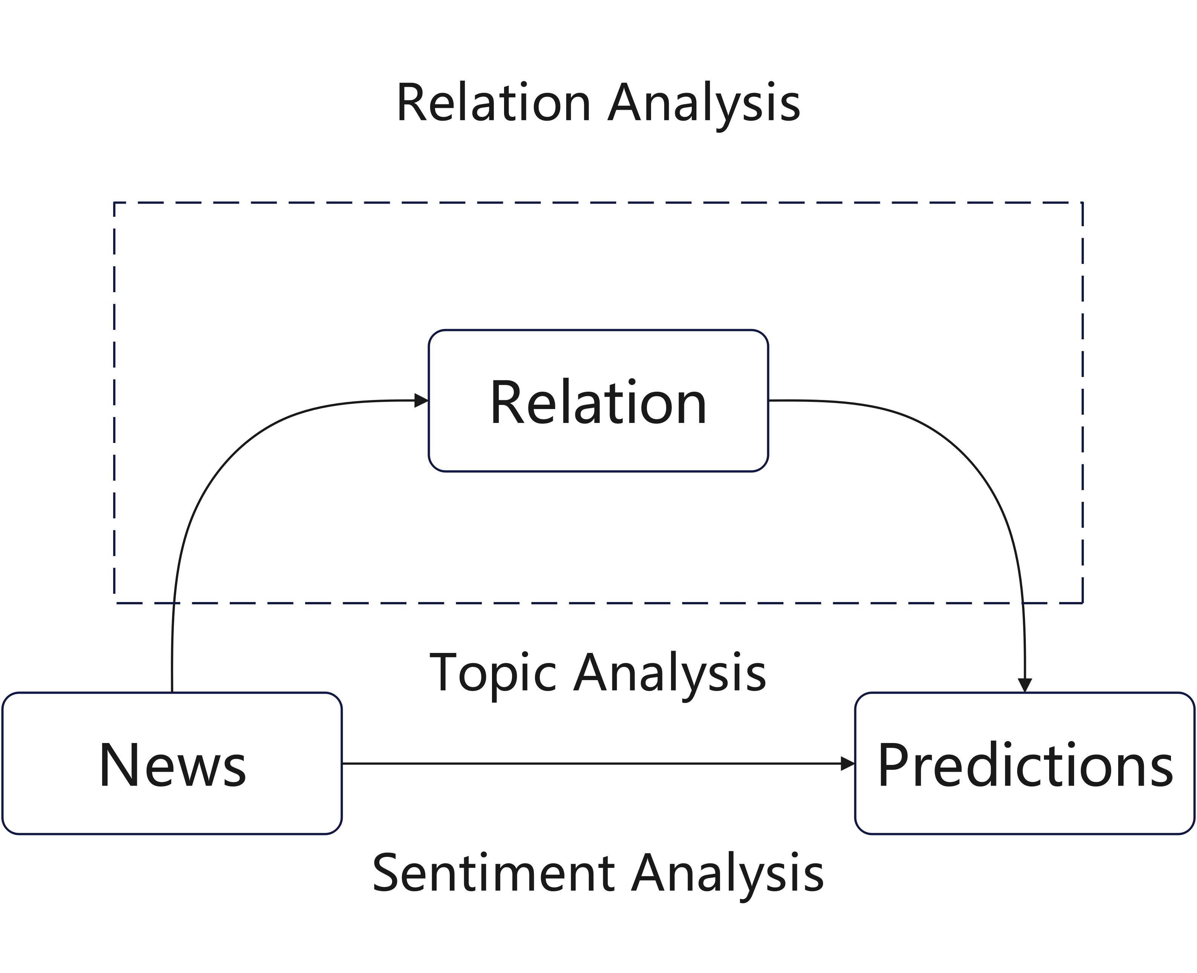
Related Work
1. Text Mining for Dynamic Market Signals:
event/topic analysis
sentiment analysis
relation analysis: using financial text-mining approach to identify firm relation. Bao et al. (2008) found that a company is more likely to co-occur with its competitors/partners in news, which indicates the business implications of co-mention relations.

Slide 9
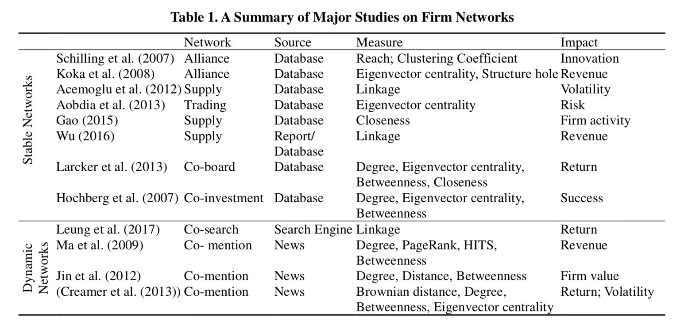
Related Work
2. Competitive Environment, Stable Firm Networks, and Their Economic Implications
Key classification criteria: What’s the semantics of network? How to get it? How to extract key information from network? What’s the impact of it?

Slide 10
Research Opportunities
Although some works do not rely on news, approaches utilizing news sources are prevalent. A key challenge, however, lies in effectively capturing the relationships between news items. Current methods, particularly those involving dynamic networks, are insufficient for thoroughly mining these connections, as dynamic network models have been largely unexplored or underdeveloped.
Consequently, we propose and evaluate a novel network designed to address this limitation.

Slide 11
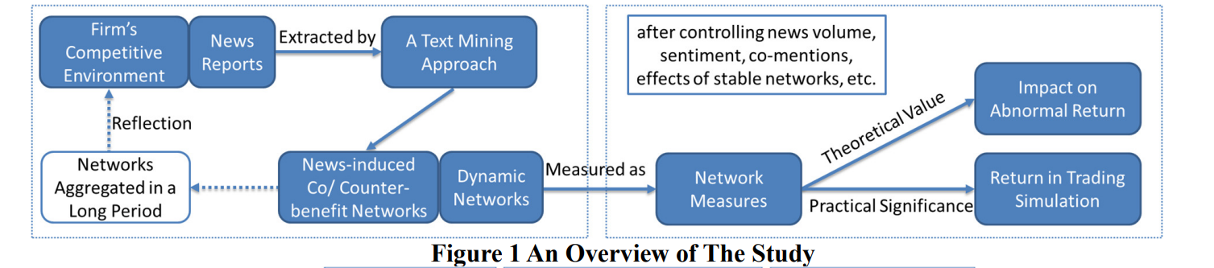
Research Overview
Network Construction: A novel text-mining approach.
Semantic Interpretation: Comparing with existing networks.
Impact Assessment: Econometric modeling.

Slide 12
Network Definition
Definition 1 (Co-benefit Relationship and Counter-benefit Relationship). Given two firms involved in one news event, if the event has the same direction (positive or negative) of impacts on the two firms, they have a co-benefit relationship. If the event has an opposite direction (positive and negative) of impacts on the two firms, they have a counter-benefit relationship.
Clarification: These relations are obviously not equivalent to alliance or competitor relations as discussed in the traditional competitive environment literature. However, such “inaccurate” relations may be statistically relevant to firm cooperative and competitive relations.

Slide 13
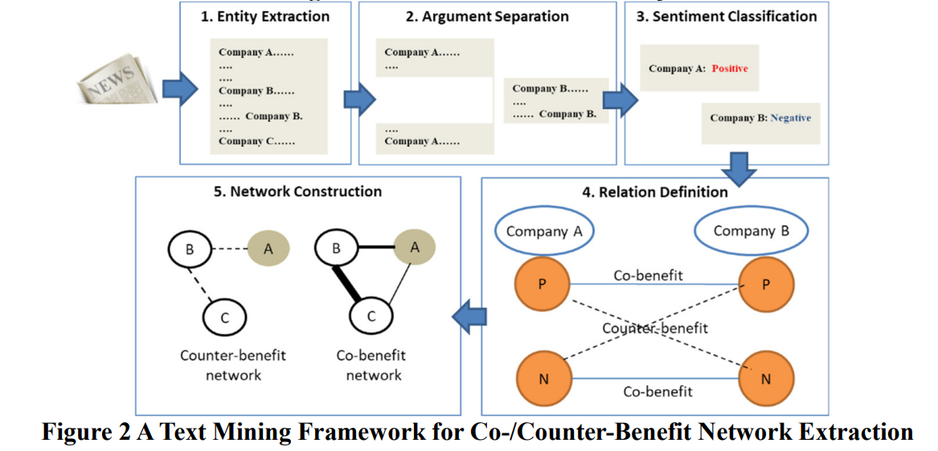
Methods Overview

Slide 14
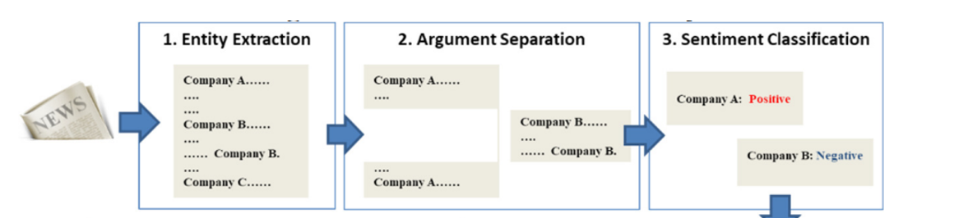
Methods
Entity Extraction: Employing a name-matching method and use a list of company names/short names/alias and product brands to identify firms.
Argument Seperation: First, segmenting news articles into sentences on the basis of punctuation, e.g., full stop, exclamation mark or question mark. Then, compiling all sentences related to a firm into one argument.
Sentiment Classification: Leveraing target-dependent feature models.

Slide 15
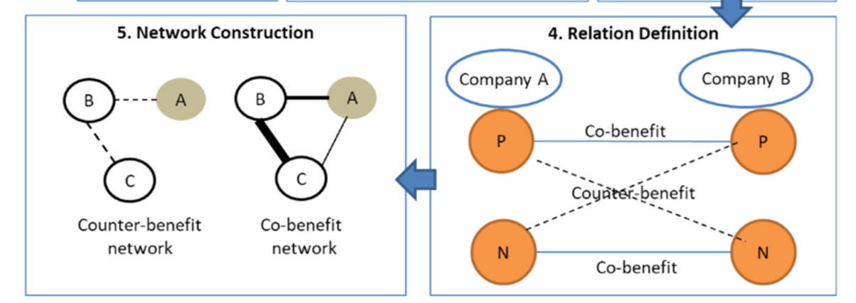
Methods
Relation Definition: If two firms in a piece of news have the same sentiment (positive or negative), they are considered to have a co-benefit relation. If one piece of news expresses opposite opinions on two firms, the two firms are considered to have a counter-benefit relation.
Network Construction: aggregate the co-/counter-benefit relations to two networks, in which the nodes are firms and the links are weighted by the frequency of two firms having certain relations within the sample.

Slide 16
Evaluation of Network Extraction Approach
1 evaluate lexicon-based entity extraction:
We randomly select 50 news articles and invite a coder and conduct a simple task to read these news articles and identify 39 firms in 212 places. We calculate the performance of the automatic method in identifying each firm’s name, Our algorithm achieves an average precision of 91.94%, an average recall of 92.31%, an average F-measure of 92.11%, and an average accuracy of 91.94%, which are quite high in general machine learning tasks.

Slide 17
Evaluation of Network Extraction Approach
2 evaluate argument sentiment classification:
We recruited 3 coders to label the data for a gold standard, where all coders had sufficient knowledge of finance, received training on the argument separation process, and learned sentiment classification examples for a mutual understanding of the task.
To deal with the target-dependent sentiment analysis problem, we adopt four feature generation methods and implement 3-category classifiers using different machine learning algorithms. the features generated by the simple distance method combined with the SVM classifier perform significantly better (with an F-measure of 70~80% for the positive and negative instances) than all other methods. The performance is sufficient for further analysis according to Deng et al. (2018).

Slide 18
Evaluation of Network Extraction Approach
3 evaluate the effectiveness of the overall relation extraction process:
We first randomly select 150 news articles and ask the three coders to code co-/counter-benefit relations based on their reading of news articles. Their coding results have excellent/substantial agreement. We consider the 321 mutually agreed relations by all coders, including 283 co-benefit relations and 38 counter-benefit relations, as the gold standard. After being applied to the sampled news articles, the algorithm detects 357 relations.
Compared with the gold standard with 321 relations, the algorithm has 95% accuracy (77% F-measure) in detecting counter-benefit relations and 73% accuracy (81% F-measure) in detecting co-benefit relations.

Slide 19
Data
We collect Chinese news in 2013 using 300 firms’ names (or alias) listed in the CSI 300 index from a general web crawler that searches 3000+ online sources. These sources cover China’s major financial media and also include popular financial portals. In total, we collect 567,352 pieces of news.
Since the data sources often report on the same events, there is considerable overlap (repeated or reprinted news) across the sources. We use cosine similarity to detect reprints within a 10-day time window. Finally, our dataset contains 211,297 unique news articles.
If too many firms are mentioned in an article, firm relations may be too complicated to assess and less informative to investors (Jin et al. 2012). To address this concern, we set a threshold for the number of firms mentioned in news.

Slide 20
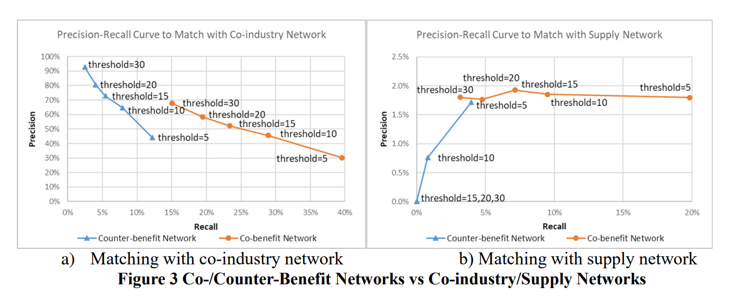
Understanding Network Semantics
To further understand the semantics of the network, we:
Obtain co-industry relations from Wind’s third-level industry catalogue, and retrieve the Supply Chain Network (at the primary level) from CSMAR.
Filter out noise based on the frequency of different relationships.

Slide 21
Understanding Network Semantics
Counter-benefit firms are more likely to be co-industry (competitors) than co-benefit firms.
Co-benefit firms have good coverage of supply-customer partners.
Counter-benefit firms are very unlikely to be supply-customer partners, whereas co-benefit firms could be supply-customer partners.

Slide 22
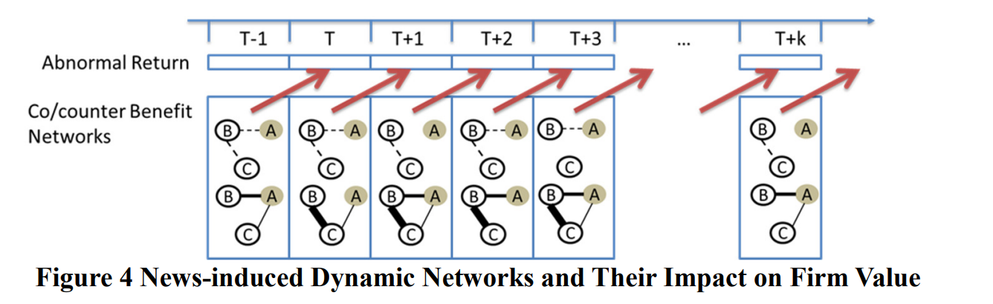
Understanding Network Semantics
We aggregate co-/counter-benefit networks in a short-term to generate dynamic networks, which better represent news dynamics that cannot be reflected by using official reports, statistics and economic data.
We set the time period of building dynamic networks to be at the daily level.
Observations signal that dynamic networks are able to capture market dynamics and can work as a market signal.

Slide 23
Impacts of Networks on Firm Equity Value
While dynamic networks better reflect news fluctuations, a remaining question is whether such networks have an impact on the stock market as market signals.
To answer this question, we conduct an empirical study by employing firm centrality measures to convert daily dynamic networks to firm-level time series data to predict firm performance on the next trading day. In the empirical study, we control for various factors used in previous research.

Slide 24
Firm Centrality
We adopt a weighted version of two widely used network measures, degree and PageRank, to assess firm centrality in networks as market signals. Degree is a local measure and PageRank is a global measure with similar implications.
In a co-benefit network, degree and PageRank reflect the extent to which nodes attract attention and receive support from other firms.
In a counter-benefit network, degree refers to the number of firms that have direct interest conflicts with the focal firm, with a higher degree indicating a tougher competitive environment. PageRank further assesses whether a firm is involved in tough competition in terms of the number of competitors and the extent of pressure that each competitor exerts on the firm.

Slide 25
Hypothesis Development
H1: Differentiating co-benefit and counter-benefit relations from news articles yields a better prediction of firm equity value than using the co-mention relationship and conventional sentiment analysis methods.
H2: A more central firm in co-benefit networks predicts higher firm equity value, while a more central firm in counter-benefit networks predicts lower firm equity value.
H3: The impact of counter-benefit networks on market is realized faster than that of co-benefit networks, while the impact of counter-benefit networks on market lasts longer than that of co-benefit networks.

Slide 26
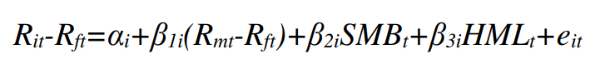
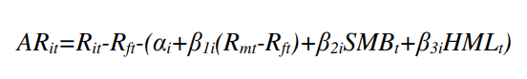
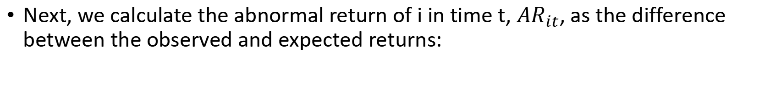
Econometric Model
We use abnormal return to measure firm equity value, so we first estimate the difference between stock return and risk-free return using the Fama French 3-factor model:
Next, we calculate the abnormal return of i in time t, ${AR}_{it}$, as the difference between the observed and expected returns:

Slide 27
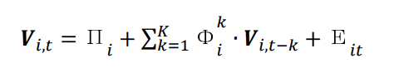
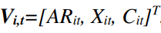
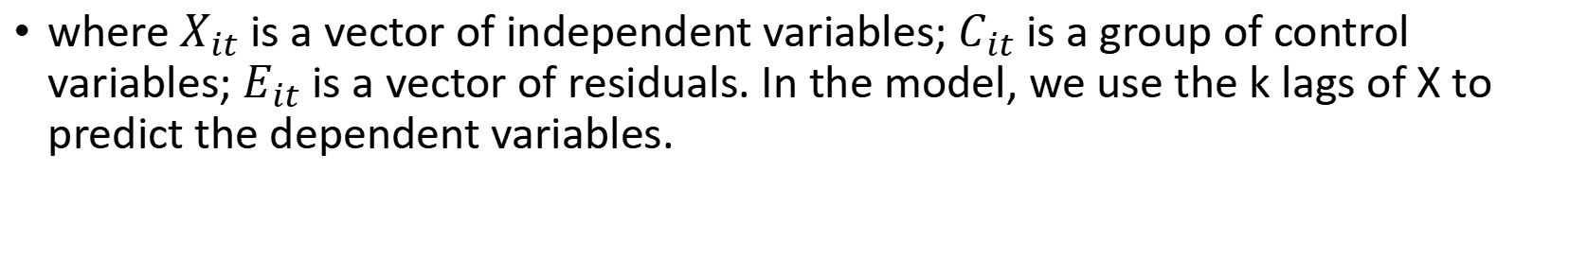
Econometric Model
The VAR model allows us to account for biases of endogeneity and autocorrelations. We adopt the VAR model to test the impacts of a firm’s competitive environments on abnormal returns.
where$X_{it}$ is a vector of independent variables; $C_{it}$ is a group of control variables; $E_{it}$ is a vector of residuals. In the model, we use the k lags of X to predict the dependent variables.

Slide 28
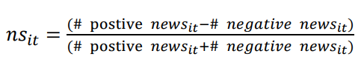
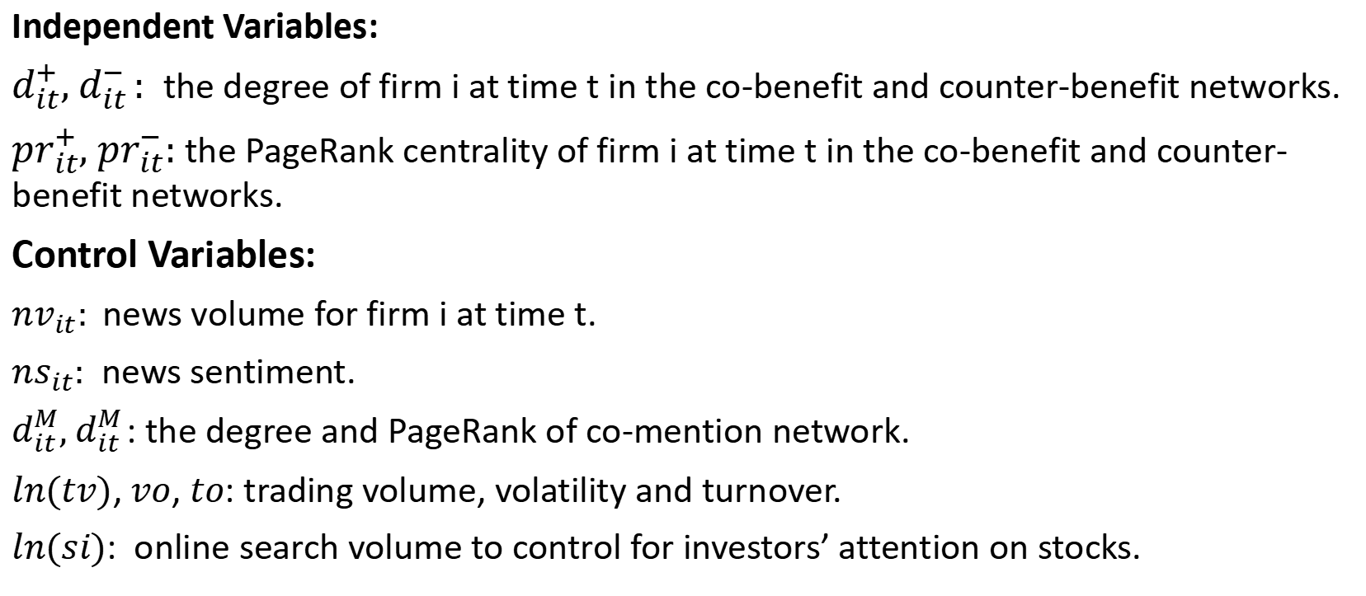
Econometric Model
Independent Variables:
$d_{it}^{+}, d_{it }^{−}$: the degree of firm i at time t in the co-benefit and counter-benefit networks.
${pr}_{it}^{+}, {pr}_{it}^{−}$: the PageRank centrality of firm i at time t in the co-benefit and counter-benefit networks.
Control Variables:
${nv}_{it}:$news volume for firm i at time t.
${ns}_{it}:$ news sentiment.
$d_{it}^{M}, d_{it }^{M}$: the degree and PageRank of co-mention network.
$ln(tv)$, $vo$, $to$: trading volume, volatility and turnover.
$ln(si)$: online search volume to control for investors’ attention on stocks.

Slide 29
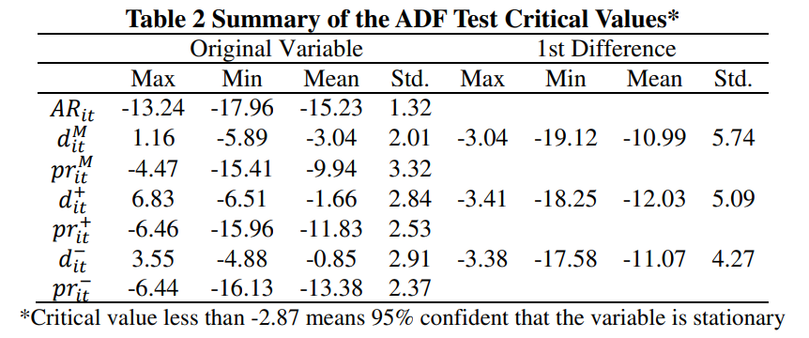
Empirical Analysis of the Banking Industry
In this test, if the critical value is less than -2.87, the null hypothesis of a unit root is rejected at the 95% confidence level, which means that the variable is stationary and stable. For the variables that are non-stationary (for any firms), we calculate their first-order differences and repeat the test.

Slide 30
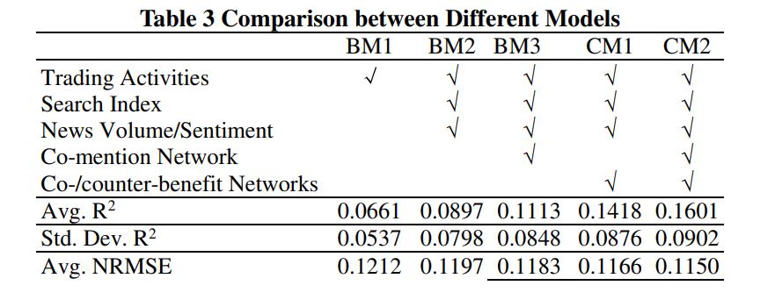
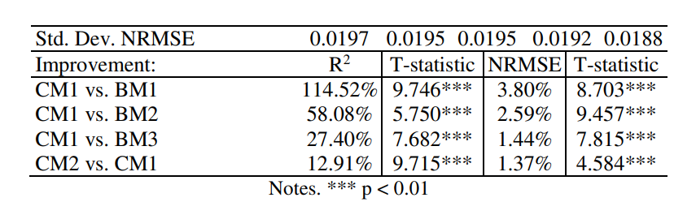
Empirical Analysis of the Banking Industry
CM1 significantly outperforms the baseline models show that differentiating co-/counter-benefit relations does improve the prediction of firm equity value. Hypothesis H1 is supported.

Slide 31
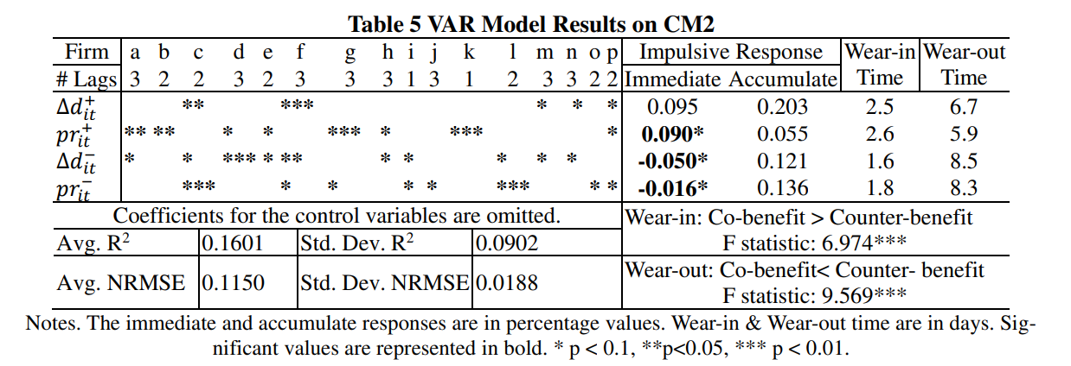
Empirical Analysis of the Banking Industry
H2: Impact Magnitude
H2a (Partial Support): Higher influence (PageRank) in Co-Benefit network → Positive immediate equity impact.
H2b (Supported): Higher prominence (Degree/PageRank) in Counter-Benefit network → Negative immediate equity impact.

Slide 32
Empirical Analysis of the Banking Industry
H3: Impact Timing & Duration
H3a (Supported): Counter-Benefit impact materializes Faster (shorter ‘wear-in’ time).
H3b (Supported): Counter-Benefit impact Lasts Longer (longer ‘wear-out’ time).

Slide 33
Other Empirical Analysis
Roubustness check
Including Additional Firm Centrality Measures, Enlarging Time Window of Network Construction, Filtering out News on Market Movement, The News Outbreak in December 2013, Alternative Econometric Models
Extending to The Entire Dataset
Performance across Industries, Impact of News Quantity
Improvement over Stable Networks

Slide 34
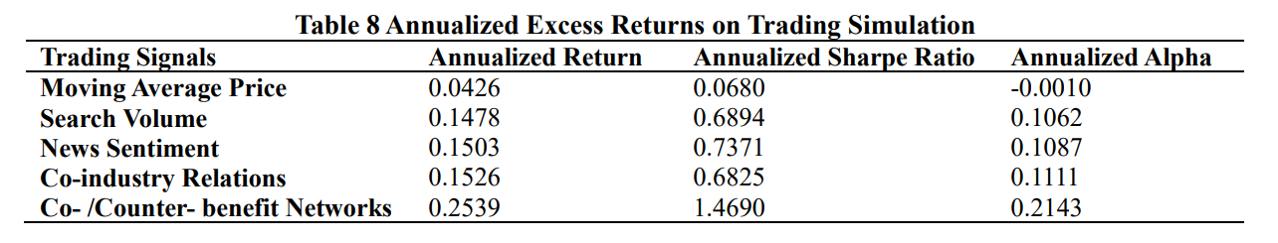
Trading Simulation
We conduct investment simulations on 300 stocks in the CSI 300 index in the second half of 2013, which is characterized by a relatively bearish market environment.
The results illustrate the practical value of the proposed networks, which should be exploited by investors.

Slide 35
Implications
Theortical Implications:
First, our study proposes an innovative approach to deciphering firms’ competitive environment from news through co-/counter-benefit networks.
Second, this paper shows that the news-induced networks have an impact on financial market through investors’ perception and attention.
Practical Implications:
First, it reveals that co-/counter-benefit networks have predictive power for firm equity value.
Second, the co-/counter-benefit networks may also be used to understand the structure of economy.

Slide 36
Conclusions and Discussions
Conclusions: we develop an approach to extract co-/counter-benefit networks from news that are semantically relevant to firm competitive environment and show the impact of news-induced dynamic networks on firm equity value.
Discussions: I don’t think it’s necessary to emphasize whether this paper belongs to design science or economics. In reality, This demonstrates that the boundaries between design science and economics are gradually becoming blurred. If it is indeed necessary to emphasize the boundary between design science and economics, then this article primarily belongs to economics; the design component merely adds four independent variables to the economic model.
Jiaqi Zhou, Qingpeng Zhang, Sijia Zhou, Xin Li, and X. Michael Zhang " Unintended Emotional Effects of Online Health Communities: A Text Mining-Supported Empirical Study," MIS Quarterly, 2023, 47(1), 195-226
Yang, Yi, et al. "Unlocking the Power of Voice for Financial Risk Prediction: A Theory-Driven Deep Learning Design Approach." Mis Quarterly 47.1 (2023).

Slide 37
Appendix A: Extensions on Large Language Models
Charles Tian
Hefei University of Technology

Slide 38
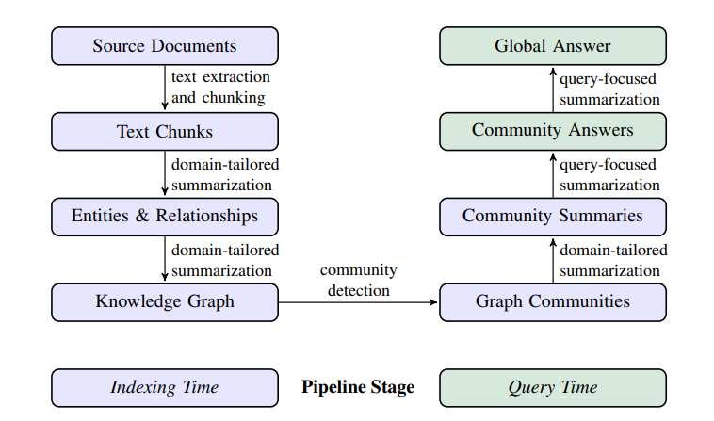
1 Graph Retrieval-Augmented Generation
[1] From Local to Global: A Graph RAG Approach to Query-Focused Summarization
[2] A Survey of Graph Retrieval-Augmented Generation for Customized Large Language Models

Slide 39
2 Human-AI Collaboration
IS
[3] Wang, Wen, Mochen Yang, and Tianshu Sun. "Human-AI co-creation in product ideation: The dual view of quality and diversity." Available at SSRN 4668241 (2023).
[4] Zhou, Eric, and Dokyun Lee. "Generative artificial intelligence, human creativity, and art." PNAS nexus 3.3 (2024): pgae052.
[5] Chen, Zenan, and Jason Chan. "Large language model in creative work: The role of collaboration modality and user expertise." Management Science 70.12 (2024): 9101-9117.
[6] Zhao, Weihong, Wen Wang, and Siva Viswanathan. "Spillover effects of generative AI on human-generated content creation: Evidence from a crowd-sourcing design platform." Available at SSRN 4693181 (2024).
[7] Lu, Tian, and Yingjie Zhang. "1+ 1> 2? Information, humans, and machines." Information Systems Research 36.1 (2025): 394-418.
CS
[8] Padmakumar, Vishakh, and He He. "Does writing with language models reduce content diversity?." arXiv preprint arXiv:2309.05196 (2023).
[9] Ding, Zijian, et al. "Harnessing the power of LLMs: Evaluating human-AI text co-creation through the lens of news headline generation." arXiv preprint arXiv:2310.10706 (2023).
[10] Li, Zhuoyan, et al. "How Does the Disclosure of AI Assistance Affect the Perceptions of Writing?." arXiv preprint arXiv:2410.04545 (2024).
HCI(Human-Computer Interaction)
[11] Ding, Zijian, and Joel Chan. "Mapping the design space of interactions in human-AI text co-creation tasks." arXiv preprint arXiv:2303.06430 (2023).
[12] Lee, Mina, Percy Liang, and Qian Yang. "Coauthor: Designing a human-ai collaborative writing dataset for exploring language model capabilities." Proceedings of the 2022 CHI conference on human factors in computing systems. 2022.

Slide 40
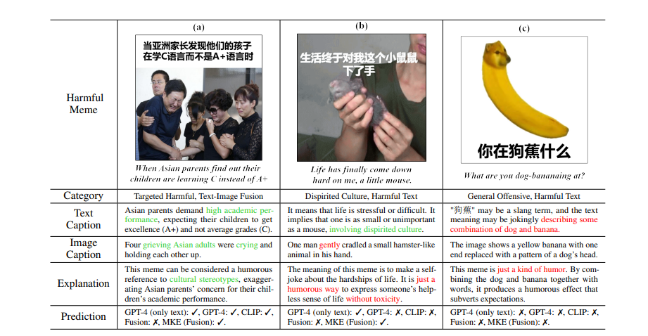
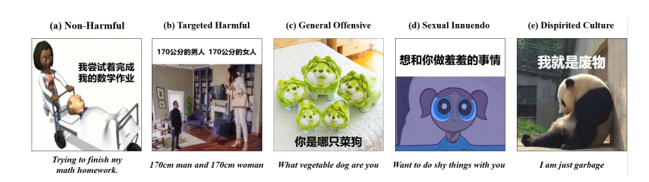
3 Interesting Applications of LLMs
[13] Cui, Jiaxi, et al. "Machine mindset: An mbti exploration of large language models." arXiv preprint arXiv:2312.12999 (2023).
[14] Cheng, Liying, Xingxuan Li, and Lidong Bing. "Is gpt-4 a good data analyst?." arXiv preprint arXiv:2305.15038 (2023).
[15] Lu, Junyu, et al. "Towards comprehensive detection of chinese harmful memes." Advances in Neural Information Processing Systems 37 (2024): 13302-13320.
[16] Ma, Weiyu, et al. "Large language models play starcraft ii: Benchmarks and a chain of summarization approach." Advances in Neural Information Processing Systems 37 (2024): 133386-133442.

Slide 41
4 Cutting-Edge LLM Design Studies in IS
[17] de Kok, Ties. "ChatGPT for textual analysis? How to use generative LLMs in accounting research." Management Science (2025).
[18] Lopez-Lira, Alejandro, and Yuehua Tang. "Can chatgpt forecast stock price movements? return predictability and large language models." arXiv preprint arXiv:2304.07619 (2023).
[19] Wang, Wen, Zhenyue Zhao, and Tianshu Sun. "Customizing large language models for business context: framework and experiments." arXiv preprint arXiv:2312.10225 (2023).
[20] Sammon, David, et al. "Exploring the Potential of Large Language Models (LLMs) for Grounded Theorizing: A Human-in-the-Loop Configuration." (2024).
[21] Zhou, Yaxian, et al. "Can ChatGPT perform a grounded theory approach to do risk analysis? An empirical study." Journal of Management Information Systems 41.4 (2024): 982-1015.
[22] Siano, Federico. "The News in Earnings Announcement Disclosures: Capturing Word Context Using LLM Methods." Management Science (2025).

Slide 42
Appendix B: Extensions on Graph
Charles Tian
Hefei University of Technology

Slide 43
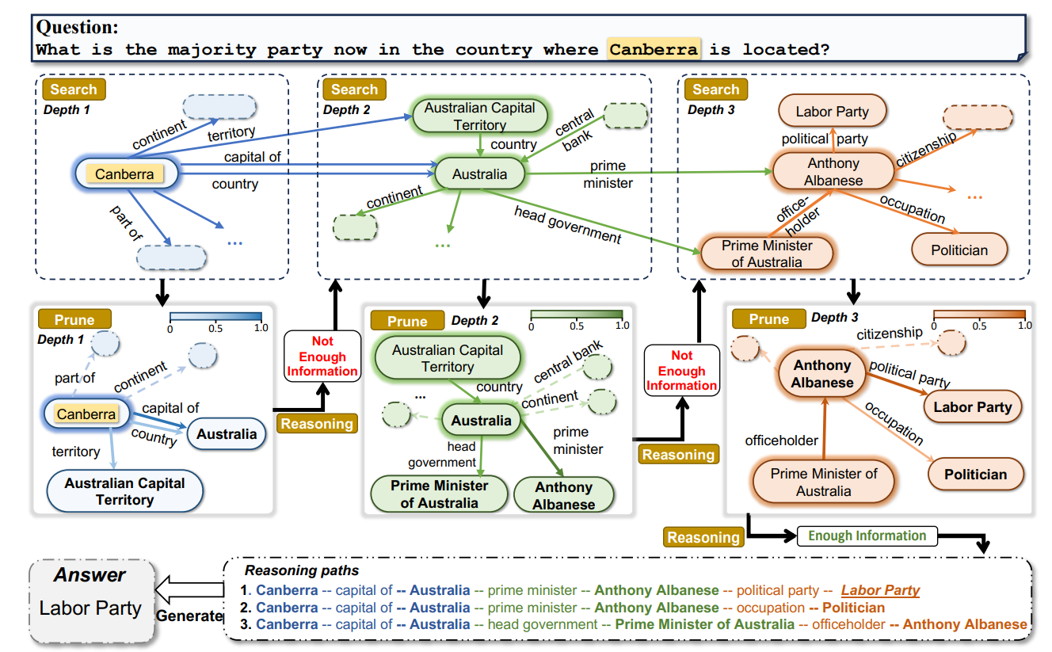
1 LLM+Graph
[1] Sun, Jiashuo, et al. "Think-on-graph: Deep and responsible reasoning of large language model on knowledge graph." arXiv preprint arXiv:2307.07697 (2023).
[2] Li, Yuhan, et al. "A survey of graph meets large language model: Progress and future directions." arXiv preprint arXiv:2311.12399 (2023).

Slide 44
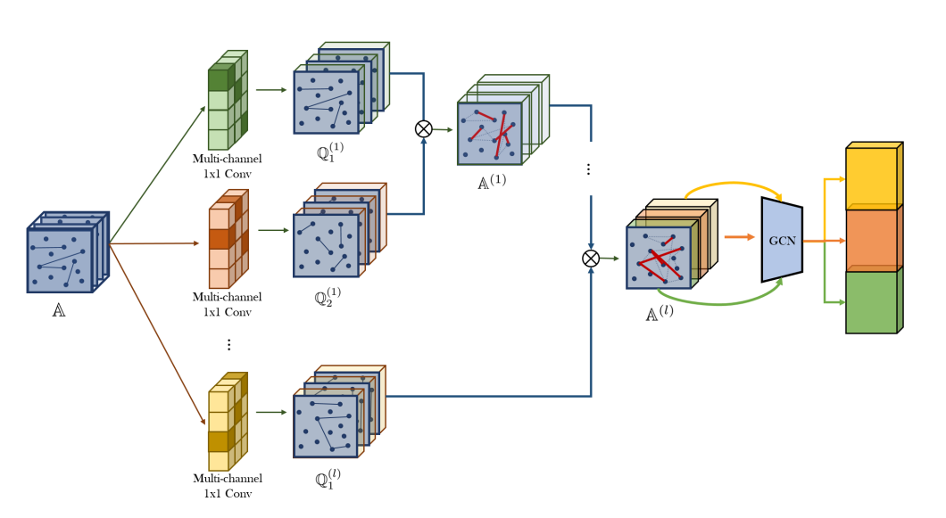
2 Graph Transformer
Graph Transformer Networks
[3] Yun, Seongjun, et al. "Graph transformer networks." Advances in neural information processing systems 32 (2019).

Slide 45
2 Graph Transformer
Pros:
Capturing long-range dependencies(Higher-order relationship)
Potentially Reduced Reliance on Explicit Graph Structure
Cons:
High Computational Complexity
Need for Explicit Structural/Positional Encoding
[4] Min, Erxue, et al. “Transformer for graphs: An overview from architecture perspective.” arXiv preprint arXiv:2202.08455 (2022).

Slide 46
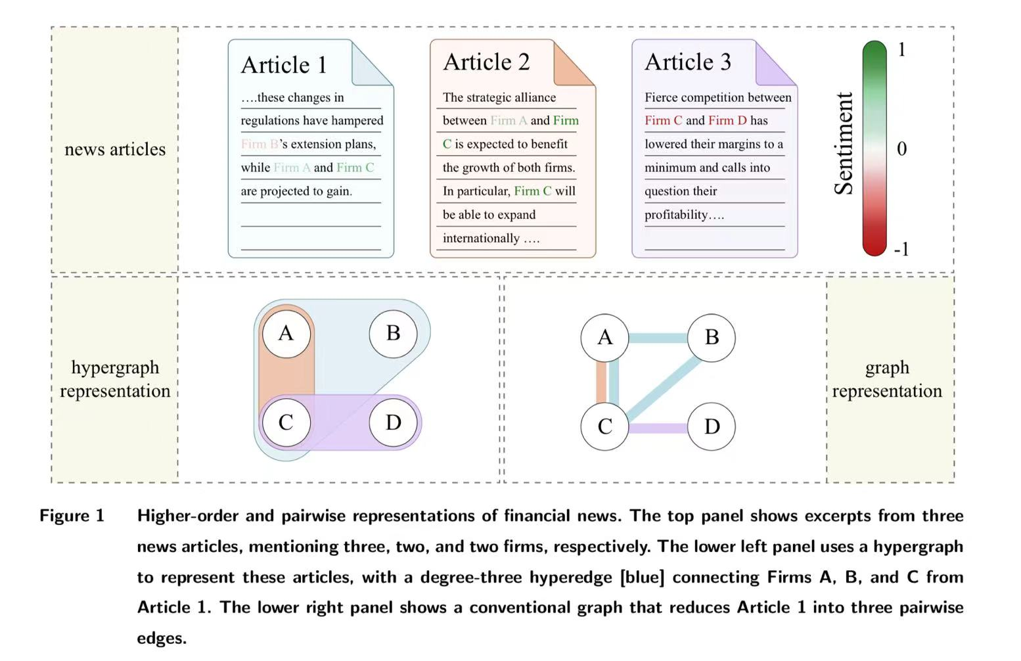
3 Cutting-Edge Graph Studies in IS
[5] Lera, Sandro Claudio, and Yan Leng. "Beyond Pairwise Network Interactions: Implications for Information Centrality." Available at SSRN 4708802 (2024).
[6] Liu, Jing, et al. "Beyond Complements and Substitutes: A Graph Neural Network Approach for Collaborative Retail Sales Forecasting." Information Systems Research (2025).

Slide 47
Something Interesting
In CS community, we now believe that graph construction is more important than improving the GNN model/architecture for two reasons:
1. Our graph data quality is too poor because the dataset is too simplistic, too sparse, and suffers from several other issues such as false neighbor.
2. Large language model serves as a higher-dimensional approach to understand the semantic of relations. OpenAI indicates that GPT-4.1 support up to 1 million tokens of context, which may demonstrate that we can translate the full graph into natural language and feed them to llms.
[7] https://mp.weixin.qq.com/s/h-_a7CLsgQw3iNjSW8YJEQ 曾经火热的Graph Embedding和GNN在推荐系统上还有前途吗？
[8] https://openai.com/index/gpt-4-1/

